Slide 1
BIO727P GROUP SOFTWARE PROJECT
TEAM CELINE
Celine, Amanah & Gracia ​
04.03.2022
Notes:
CELINE: Introduction

Slide 2
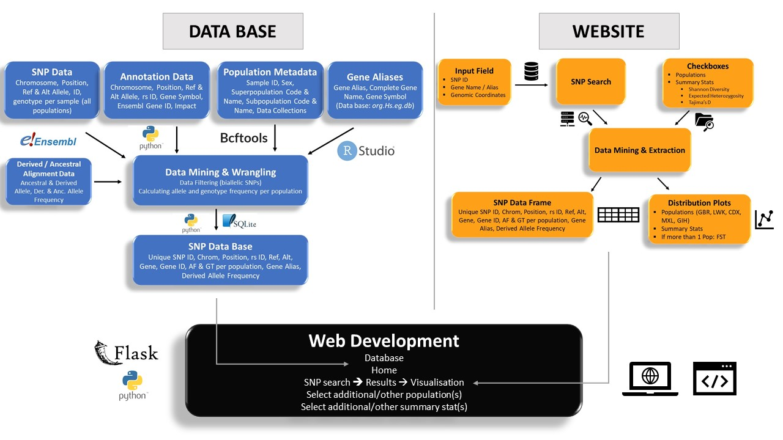
VCFtools
Notes:
DATABASE HALF – GRACIA
WEBSITE HALF - CELINE

Slide 3

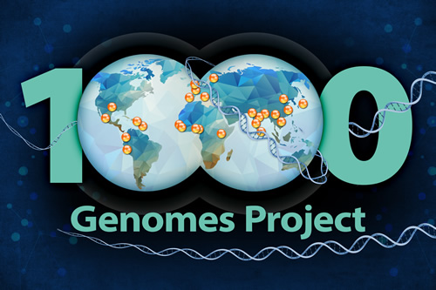

Data Collection
SNP VCF files from Ensembl FTP Server
Population Sample Data from 1000 Genomes Project
Gene Alias from Org.Hs.eg.db - R Bioconductor package containing genome wide annotation for Human genome
Notes:
AMANAH

Slide 4
Population Selection
British
(GBR)
Dai-Chinese
(CDX)
Gujarati
(GIH)
Mexican
(MXL)
Luhya
(LWK)
Notes:
AMANAH

Slide 5
Walk-through for allele and genotype frequency processing
Table 1:
1. Convert numbers to letters
2. Calculate allele counts, frequencies and genotype frequencies per population using genetics::genotype() and summary() in R
3. Frequencies joined to SQL database (see Table 2)
Ref | Alt | Samples (numeric) | Samples (base)
A | G | 0|0 | A|A
T | C | 0|1 | T|C
A | T | 1|1 | T|T
Table 2:
GBR_AF_ref | GBR_AF_alt | GBR_GT00 | GBR_GT0110 | GBR_GT11
1 | 0 | 1 | 0 | 0
1 | 0 | 1 | 0 | 0
1 | 0 | 1 | 0 | 0
Notes:
GRACIA

Slide 6
Walk-through for derived allele frequency processing
1. Extract position and ancestral allele field from VCF
2. Remove SNPs with missing ancestral allele by position
3. Calculated derived / ancestral allele frequencies
4. Join ancestral and derived alleles to database
Justification: determine the occurrence of a mutated/derived allele in the human population which arose after recent divergence from outgroup
Extraction
Filtering
Calculating frequencies
Joined to SQL database
Notes:
AMANAH

Slide 7
SNP Database
SNP_Data_Table
Unique_SNP_ID | Gene
Chromosome | Gene ID
Position | AF & AC per population
rsID | GT per population
Ref | Gene Alias
Alt | Derived Allele Frequency
Example of Unique SNP ID:
22 : 50807605 : C : A
Notes:
CELINE
Explain unique ID

Slide 8
Features of Software
SNP search
Browse for SNPs via rs ID, Gene Name (or Alias), or Genomic Coordinates
Summary statistics selection​
Shannon Diversity, Expected Heterozygosity and Tajima’s D
FST Analysis
Population selection​
Choose one or more of the 5 provided populations
Download stats as TXT
Download the FST or other stats​ data frame as a txt file
Visualise summary stats
When choosing summary stats and population, plots are automatically shown
Notes:
CELINE

Slide 9
Choice of Summary Statistics
Shannon Diversity
More effective at describing diversity than using allele counts/richness
Sample size
Expected Heterozygosity
Study the difference in genetic variation in populations affected by urbanisation
Physiological responses e.g., disease resistance
Tajima’s D
Infer which loci were affected by natural selection by identifying difference between observed and expected allele frequencies
FST
Hudson method – not affected by change in sample size and avoid false positive signals
Notes:
AMANAH

Slide 10
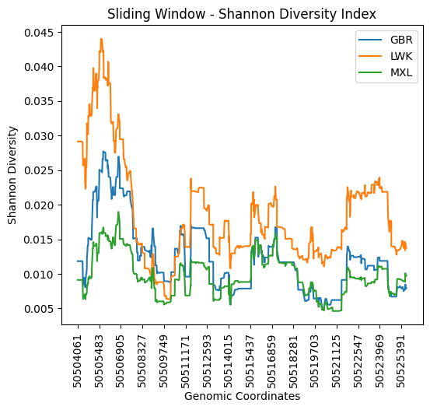
Justification for Visualisation Type
Sliding windows
X-axis: positions to avoid gaps in graph
Line graphs commonly used to demonstrate change in variability throughout the region
Overlapping uniform window size
Notes:
GRACIA
Line graphs commonly used in studies to demonstrate change in variability throughout the chromosome or within a region with genomic position as the x-axis and statistical indices as the y-axis
Overlapping windows which are distinct may reduce sampling error
however, won’t increase statistical power because split genetic events like recombination etc.
more statistical testing because of overlapping windows

Slide 11
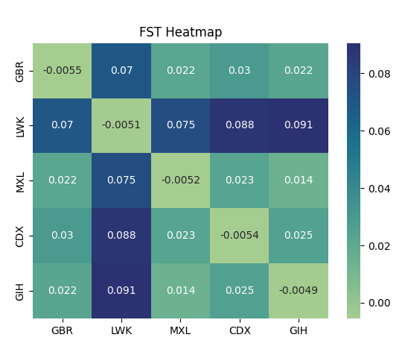
Justification for Visualisation Type
Heatmap
FST is calculated pairwise per population combination
Limited number of comparisons
Heatmap not too overloaded while easily visualizing which populations are most similar/different to each other
Notes:
GRACIA:
Sliding window
Heatmap

Slide 12
Software Demo
Celine will show our web application now

Slide 13







Limitations & Opportunities
Only 5 populations
Bi-allelic SNPs
Indels or structural variants ignored
Uniform window size
Overlapping windows ➔ less statistical power
Interactive graphs
Notes:
GRACIA

Slide 14


Thank you for listening!
Questions or comments?

Slide 15



Individual Contributions
 | Amanah | Celine | Gracia
Implementation | Data Pre-processing for derived allele frequency (VCFtools) | Web App incl. Flask, HTML / CSS | Data Pre-processing (bcftools) & Data Wrangling
 | Genotype & Allele Frequency Calculation | Python to SQL data base | Genotype & Allele Frequency Calculation
 | FST statistic | Tajima‘s D and Shannon diversity | Sliding Window
Documentation | Description of contributed implementation
 | Justification of summary stats | Running the software | Structure / Outline
 | Literature research / References | Database connection & query Data visualisation | Transfer documentation into LateX

Slide 16
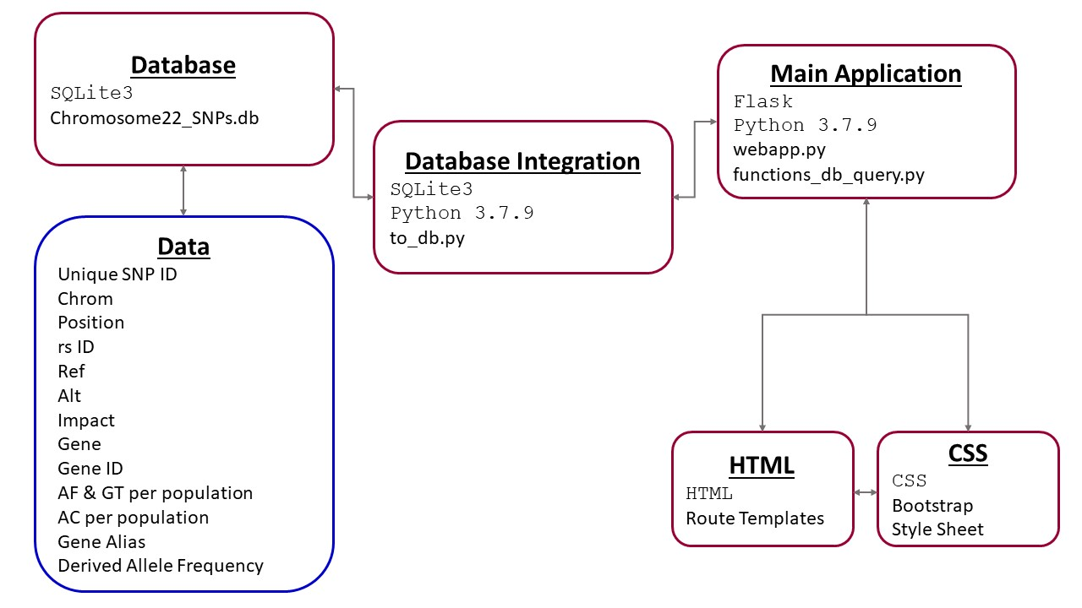
Software Architecture

Slide 17



Data Mining & Wrangling
Bcftools: pre-process VCF files by population samples
Vcftools: extract derived allele frequency for SNPs
R genetics: calculate allele counts, allele & genotype frequency
Python packages
pandas: modify, join and filter data
scikit-allele: calculate Tajima’s D & FST
pandas & math: calculate Shannon Div. & Exp. Heterozygosity

